Slide 1
Car Accident Severity

Slide 2
Introduction
In an effort to reduce the frequency of car collisions in a community, an algorithm must be developed to predict the severity of an accident given the current weather, road and visibility conditions.
When conditions are bad, this model will alert drivers to remind them to be more careful.

Slide 3
Data Understanding
Our predictor or target variable will be 'SEVERITYCODE' because it is used to measure the severity of an accident from 0 to 5 within the dataset. Attributes used to weigh the severity of an accident are 'WEATHER', 'ROADCOND' and 'LIGHTCOND'.
Severity codes are as follows:
0 : Little to no Probability (Clear Conditions)
1 : Very Low Probability - Chance or Property Damage
2 : Low Probability - Chance of Injury
3 : Mild Probability - Chance of Serious Injury
4 : High Probability - Chance of Fatality

Slide 4
Methodology
Our data is now ready to be fed into machine learning models.
We will use the following models:
K-Nearest Neighbor (KNN)
Decision Tree
Logistic Regression

Slide 5
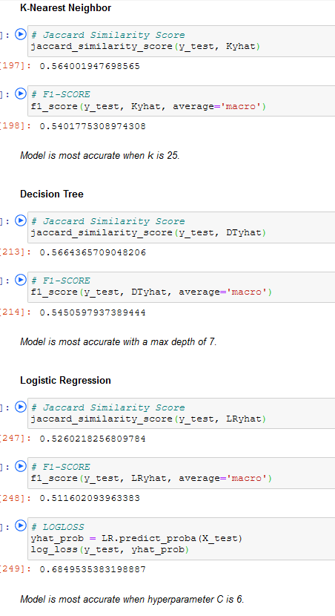
Results & Evaluation

Slide 6
Discussion
Once we analyzed and cleaned the data, it was then fed through three ML models; K-Nearest Neighbor, Decision Tree and Logistic Regression. Although the first two are ideal for this project, logistic regression made most sense because of its binary nature.
Evaluation metrics used to test the accuracy of our models were jaccard index, f-1 score and logloss for logistic regression. Choosing different k, max depth and hyparameter C values helped to improve our accuracy to be the best possible.

Slide 7
Conclusion
Based on historical data from weather conditions pointing to certain classes, we can conclude that particular weather conditions have a somewhat impact on whether or not travel could result in property damage (class 1) or injury (class 2).

Slide 8
THANK YOU!

